Slide 1
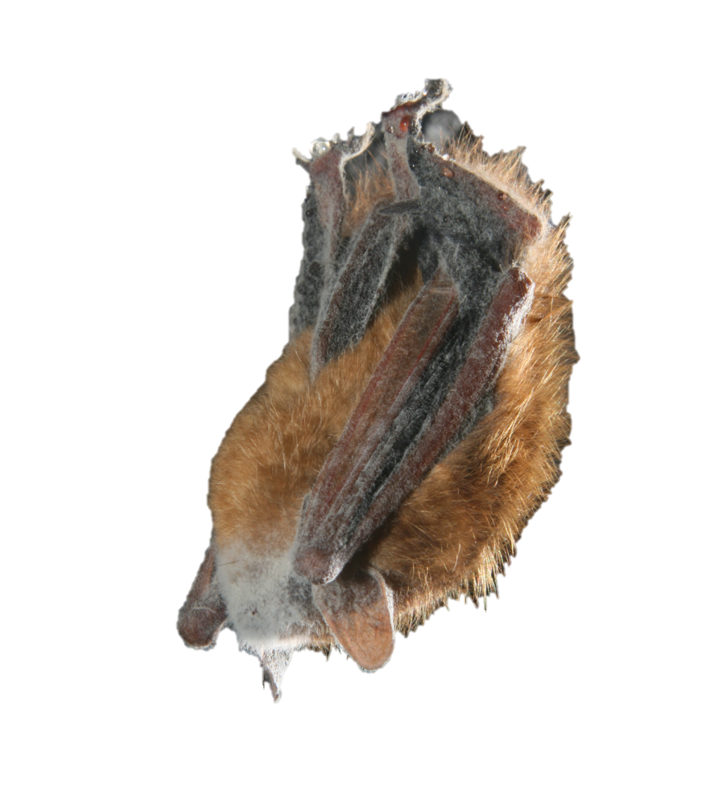
Week 3:
Biological Background on Projects
Kate E. Langwig, PhD
Associate Professor, Virginia Tech

Slide 2
Goals
Understand the biological background of two primary datasets we will use in class
Temperatures of bats (and white-nose syndrome)/
Cliff swallow populations
Discuss finding and saving literature
Re-visit groups, update collaboration agreements

Slide 3
Check-in
What questions do you still have about research question formulation?

Slide 4
Dataset 1: Bats and temperature
There are over 1400 species of bat worldwide, and they are the only mammal capable of flight
Bats diets vary immensely – they can eat fruit, nectar, insects, and even blood!
Bats that live in temperate areas (e.g. areas with 4 seasons) get through the winter by hibernating
This dataset focuses on temperatures of hibernating bats

Slide 5
Bat facts
Mammals
Microchiroptera and Megachiroptera
In eastern US all are insectivores (most/all hibernating bats are)
Not rodents!
Not high incidence of rabies (half of 1% as reported by US FWS)
Do not fly into your hair
Are not blind, but michrochiroptera do rely on echolocation

Slide 6
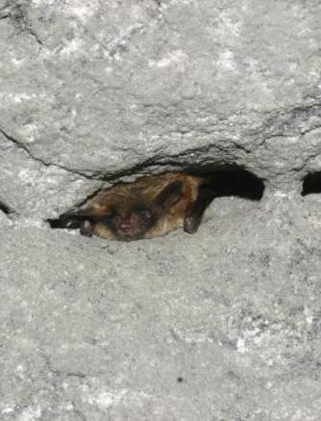
A year in the life of a Little Brown Bat
Fall (late August to mid-October)
Fall swarm
fattening and breeding
Winter (Nov – mid-Apr)
Hibernation
Spring (May- mid-June)
Emergence, pregnancy
Summer (Jun – mid-Aug)
Raising and feeding young

Slide 7
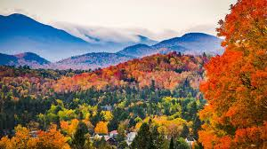
Fall Swarm
Visit multiple sites
Mating is promiscuous
Females store sperm and delay ovulation over hibernation
Sperm competition

Slide 8
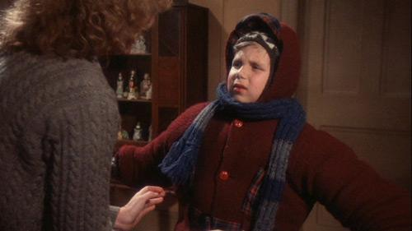
Hibernation / Torpor
Bats are euthermic and must have strategy for surviving cold winters
Survive by conserving energy
and metabolizing fat stores at a slow rate
Lower body temperature, depression of metabolic activities, lowering of heart and respiratory rate, lowering of immune response
Temperature of hibernaculum is important

Slide 9
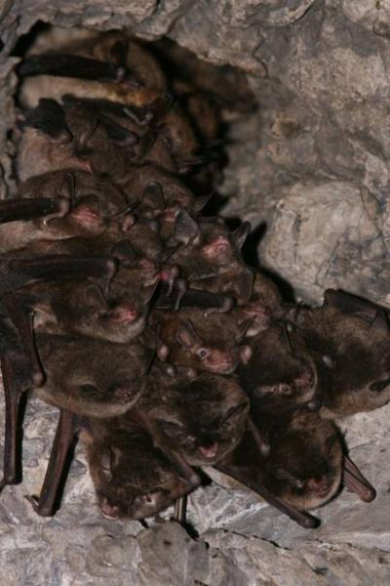
Hibernation / Torpor
Bats periodically arouse from torpor during winter (mean 13 days, for approx. 30-180 minutes, although highly variable)
Euthermic arousals account for a large amount of the reduction of energy reserves

Slide 10
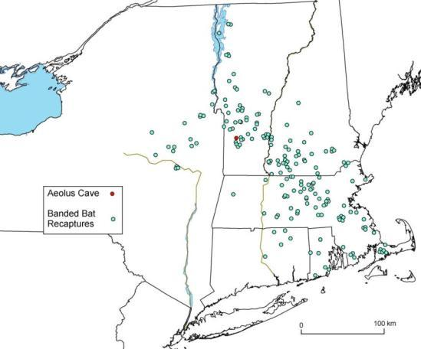
Migration to Summer Colonies
Distance varies depending on sex and species
Individuals living in mines often migrate less far than those living in caves
Females tend to migrate further than males

Slide 11
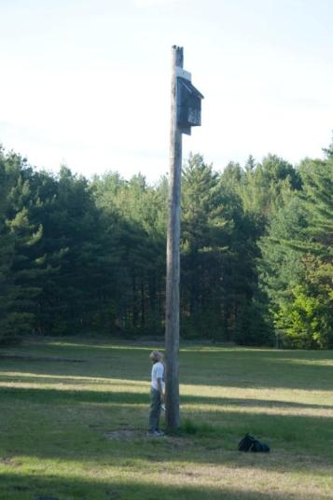
Summer
Females raise young in nursery colonies
Identify young through smell
Young fledge at about 4 weeks
Most young are non-reproductive in first year
Higher mortality among juveniles

Slide 12
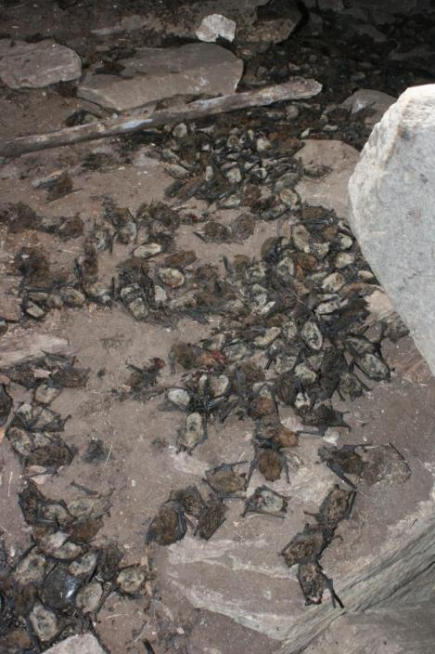
White-Nose Syndrome
Aeolus Cave, Dorset, VT, 2008

Slide 13
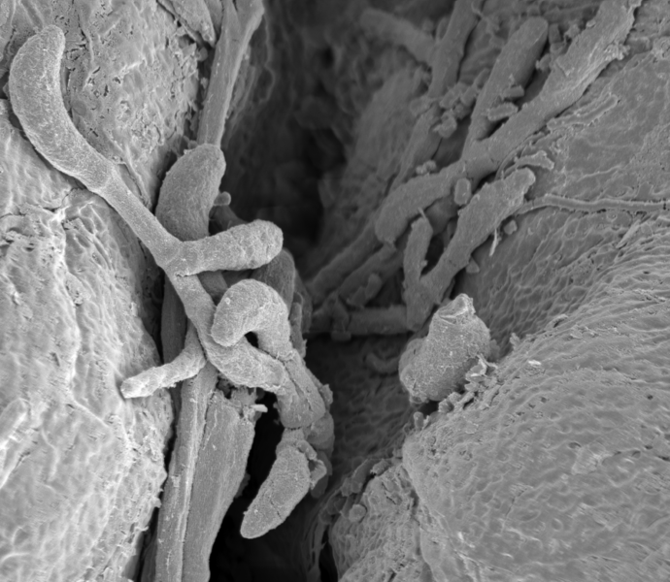
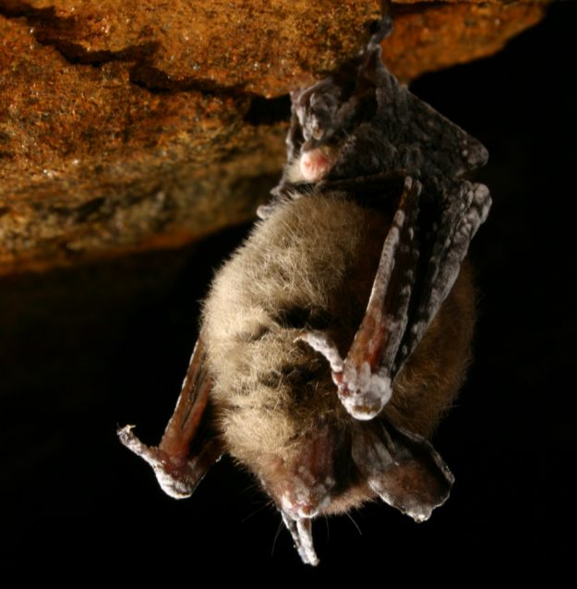
Fungal pathogen
Pseudogymnoascus destructans (Pd)

Slide 14
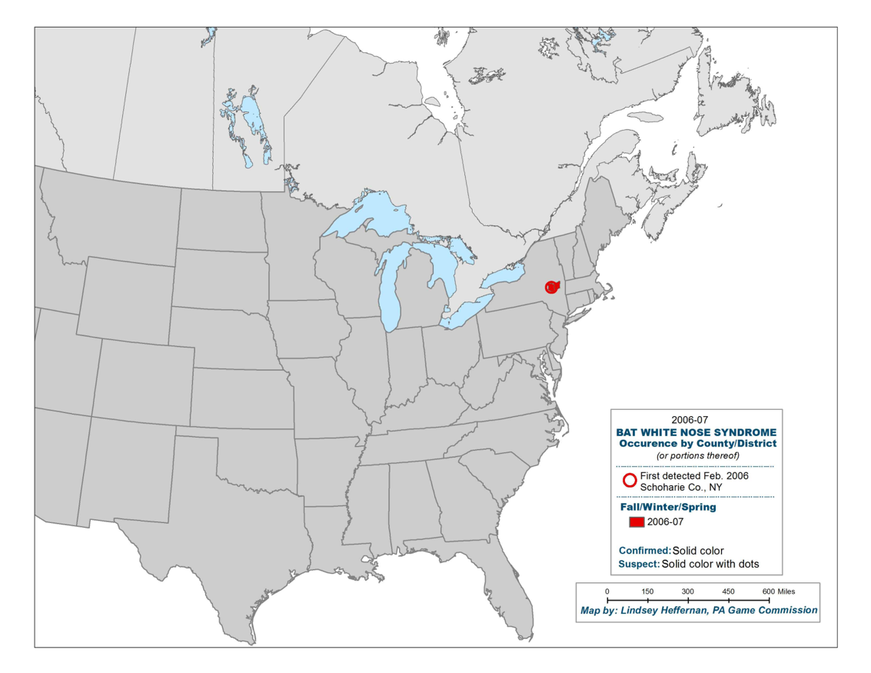
White-nose syndrome spread

Slide 15
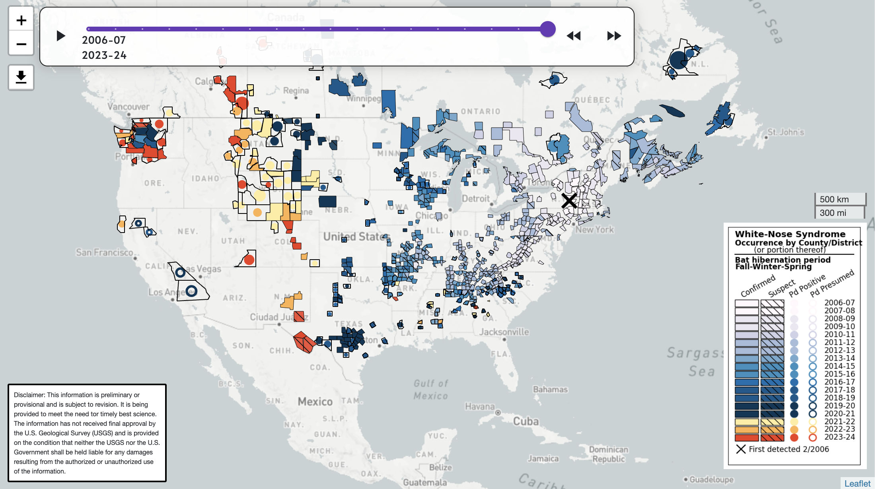
Current Distribution

Slide 16
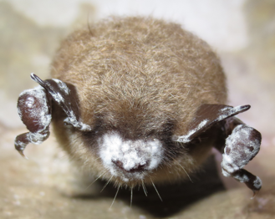
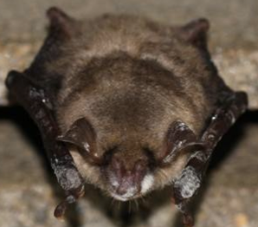
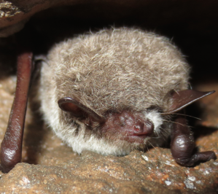
P. destructans global distribution and origins
Invading
Endemic
USA
Germany
China
Hoyt et al. 2016, Emerging Infectious Diseases

Slide 17
Fungus prefers cool conditions
Verant et al 2012 PLoS One

Slide 18
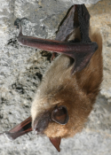
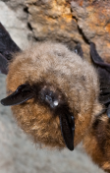
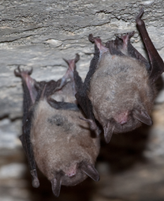
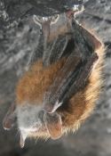
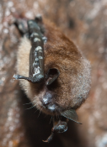
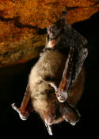
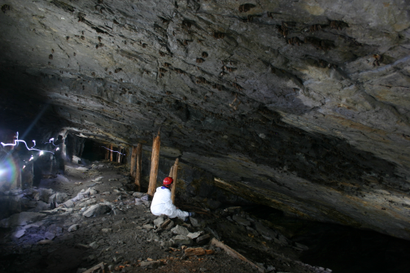
Pd in bats and the environment
Big brown
E. small-footed
Indiana
Tri-colored
Little brown
N. long-eared
Mine (Hibernacula)
Hoyt, Langwig, et al. 2015 EcoHealth
Notes:
This picture shows a graphite mine in northern New York that used to be owned by the Ticonderoga pencil company. At it’s maximum, this mine held 200,000 hibernating bats and was the largest hibernacula in the eastern U.S. It now has fewer than 500 bats.

Slide 19
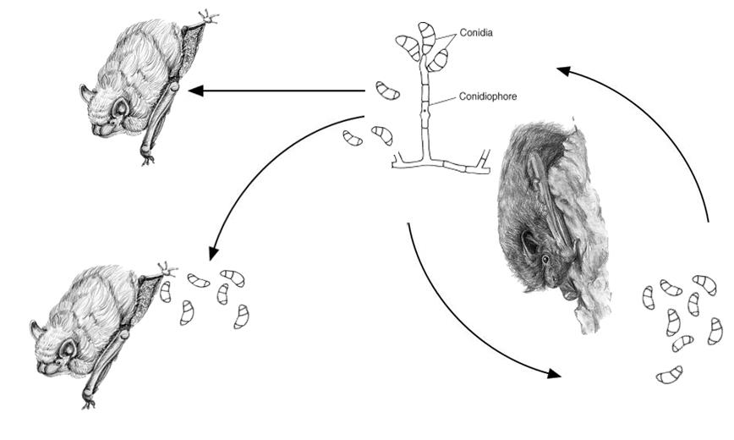
Transmission of Pd
Primarily replicating on bats
Transmission (# of secondary cases):
Bat-Bat
Bat-Environment-Bat
Notes:
Point out growth, fungus produces asexual spores or conidia, these can reinfect the same host, or be transmitted to a new host of the environment

Slide 20
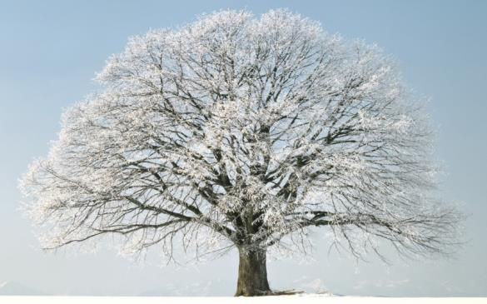
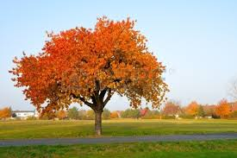

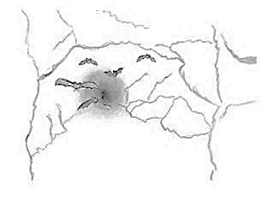
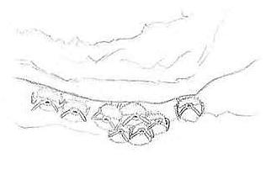
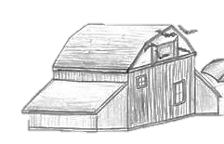
SWARM
HIBERNATION
BIRTH
Notes:
The seasonal life history of bats influences the timing of transmission and impacts. During autumn, most bats swarm around hibernacula (the caves and mines where they spend the winter). This is a time when bats fatten, mate, and prepare for winter. When the temperatures get cold and insects become less abundant, bats enter torpor, cooling their body temperatures to near ambient, suppressing all physiological processes, and only occasionally arousing for short periods. During the spring, bats migrate to species and sex segregated colonies where they give birth, in most species, to just a single pup.

Slide 21
Seasonal prevalence among species
SWARM
HIBERNATION
BIRTH
MORTALITY
Hibernation
30 sites, 4,483 bats
WNS >1 yr
Langwig et al. 2015 Proc. Roy. Soc. B; Langwig et al. 2015 EID.
Notes:
These vast changes in body temperature and contact with environmental reservoirs influences the seasonal patterns of
For all 6 species, you can see that increases in prevalence, on the y-axis, correspond to the winter period, and are driven by entry into hibernation or torpor. Likely the cold body temperature of hosts enables pathogen to better replicate. Occasional arousal bats to mate are likely responsible for huge increases in prevalence during this period, indicating that bats are still having lots of contacts during the hibernation period, and now these contacts are likely to be much more infectious. This is similar to another bat pathogen, rabies, but in contrast to rabies where hibernation allows the pathogen to persistent in a qui-escent phase, hibernation here is driving increases in pathogen prevalence in loads.

Slide 22
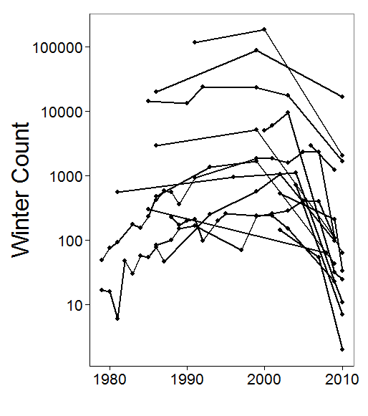
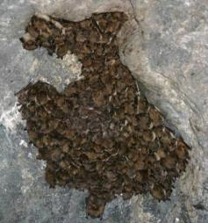
Growing bat populations crash
Little brown bat
Frick, Pollock, Hicks, Langwig et al 2010 Science

Slide 23
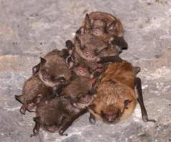
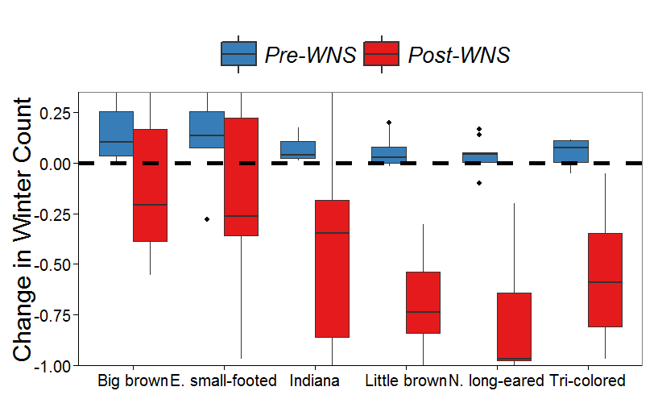
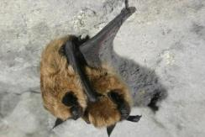
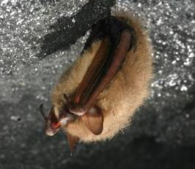
Declines in multiple species
Prior to WNS, all species growing at ~9%/year
Langwig 2012 Eco Letters
Notes:
Population change

Slide 24
Why does this matter?
All bats affected by WNS eat insects
Agricultural losses estimated $3.7 billion/year due to bat declines (Boyles 2011 Science)
Corn field experiment (Maine et al. 2015 PNAS):
Bats limit herbivory by insects
Bats also suppress pest associated fungal growth
$1 billion/yr in pest suppression on just corn
N. long eared bats caused a 32% reduction in egg laying by mosquitoes (Reiskind 2016 Jour. Med. Ent.)
Notes:
ADD in PICTURE OF CORN FIELD
MYSE EATING MOSQUITOES

Slide 25
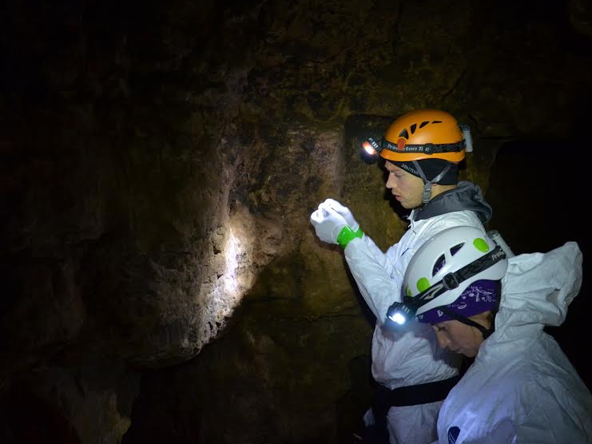
Long-term pathogen invasion and establishment project: 2012-present Wisconsin, Michigan, Illinois
At 25-30 sites, at the beginning and end of hibernation, we:
Band
Collect fungal swabs
Collect standard measurements
Count sites
Langwig, Hoyt 2015 EID; Hoyt, Langwig 2016 Proc B; Hoyt, Langwig 2018 Nature; Langwig, Hoyt 2017 Phil Trans; Hoyt, Langwig 2020 PNAS; Hoyt, Kilpatrick & Langwig 2021 Nature Reviews Micro, Langwig 2021 Jour. Animal Ecology
Notes:
A lot of the data I’m going to be discussing today builds on work we have been conducting since 2012 as part of the …. That I co-lead with Joseph Hoyt

Slide 26
Methods:
NOVEMBER:
Swab for fungal loads
Measure roosting temperatures
Band for individual ID
MARCH:
Swab for fungal loads
Measure roosting temperatures
Re-sight bands
Notes:
Each year, we sampled bats during early hibernation, when most bats have already become infected by Pd. We used a standardized swabbing method to swab bats AND useD qPCR to quantify fungal loads, we used a laser thermometer to get a ROOSTING TEMPERATURE estimate for each bat, and we banded A SUBSET OF bats FOR individual IDENTIFICATION . We repeated this sampling procedure a few months later, during late hibernation, AND RECORDED ALL banded bats PRESENT. If a banded bat wasn’t recaptured in March, it likely DIED EITHER INSIDE THE SITE OR left the hibernaculum DURING WINTER to search for food AND STARVED ON THE LANDSCAPE. Together, these data give us everything we need to see how temperature affects fungus growth and thus bat survival, and also whether temp-dependent disease impacts are affecting bat distributions

Slide 27
Epidemic: Warmer temperatures causes more severe declines in little brown bats
Langwig et al. 2012. Eco Letters.
Notes:
A lot of the initial variability in declines among species, across populations, and within individuals, ends up being determined by temperature. On the x-axis is temp, y-axis is growth rate, red line is stability, and we see populations roosting at warmer temps suffer more severe declines.

Slide 28
Epidemic: Fungal growth rates increase with temperature
Skylar Hopkins
Former Post-doc
(now Asst Prof at NC State)
Hopkins 2021 Nat Comm
Notes:
It turns out that this temperature-dependent mortality relationship is largely driven by temperature-dependent differences in the growth rate of the pathogen, at least for little brown bats. Here I am showing data from my former postdoc where bat roosting temperature of an individual bat is on the x-axis, and fungal loads on bats recaptured overwinter is on the y axis. As temperatures increase, so does the growth the fungus on bat skin, which ultimately reduces survival.

Slide 29
Warmer temperatures decrease bat survival
N=214
banded bats
Low early loads
High early loads
74%
predictive
accuracy
Hopkins 2021 Nat Comm
Notes:
And that’s just what we saw. On the x-axis is roosting temp, and the y is....
There’s a negative relationship between temperature and the probability that a bat is recaptured in the spring. Additionally, bats with higher fungal loads during early hibernation are less likely to be recaptured in the spring. Using K-fold cross-validation, we found that knowing the early fungal load and early roosting temp for a given bat, you can predict w/ 73% accuracy whether that bat will die from infection during hibernation

Slide 30
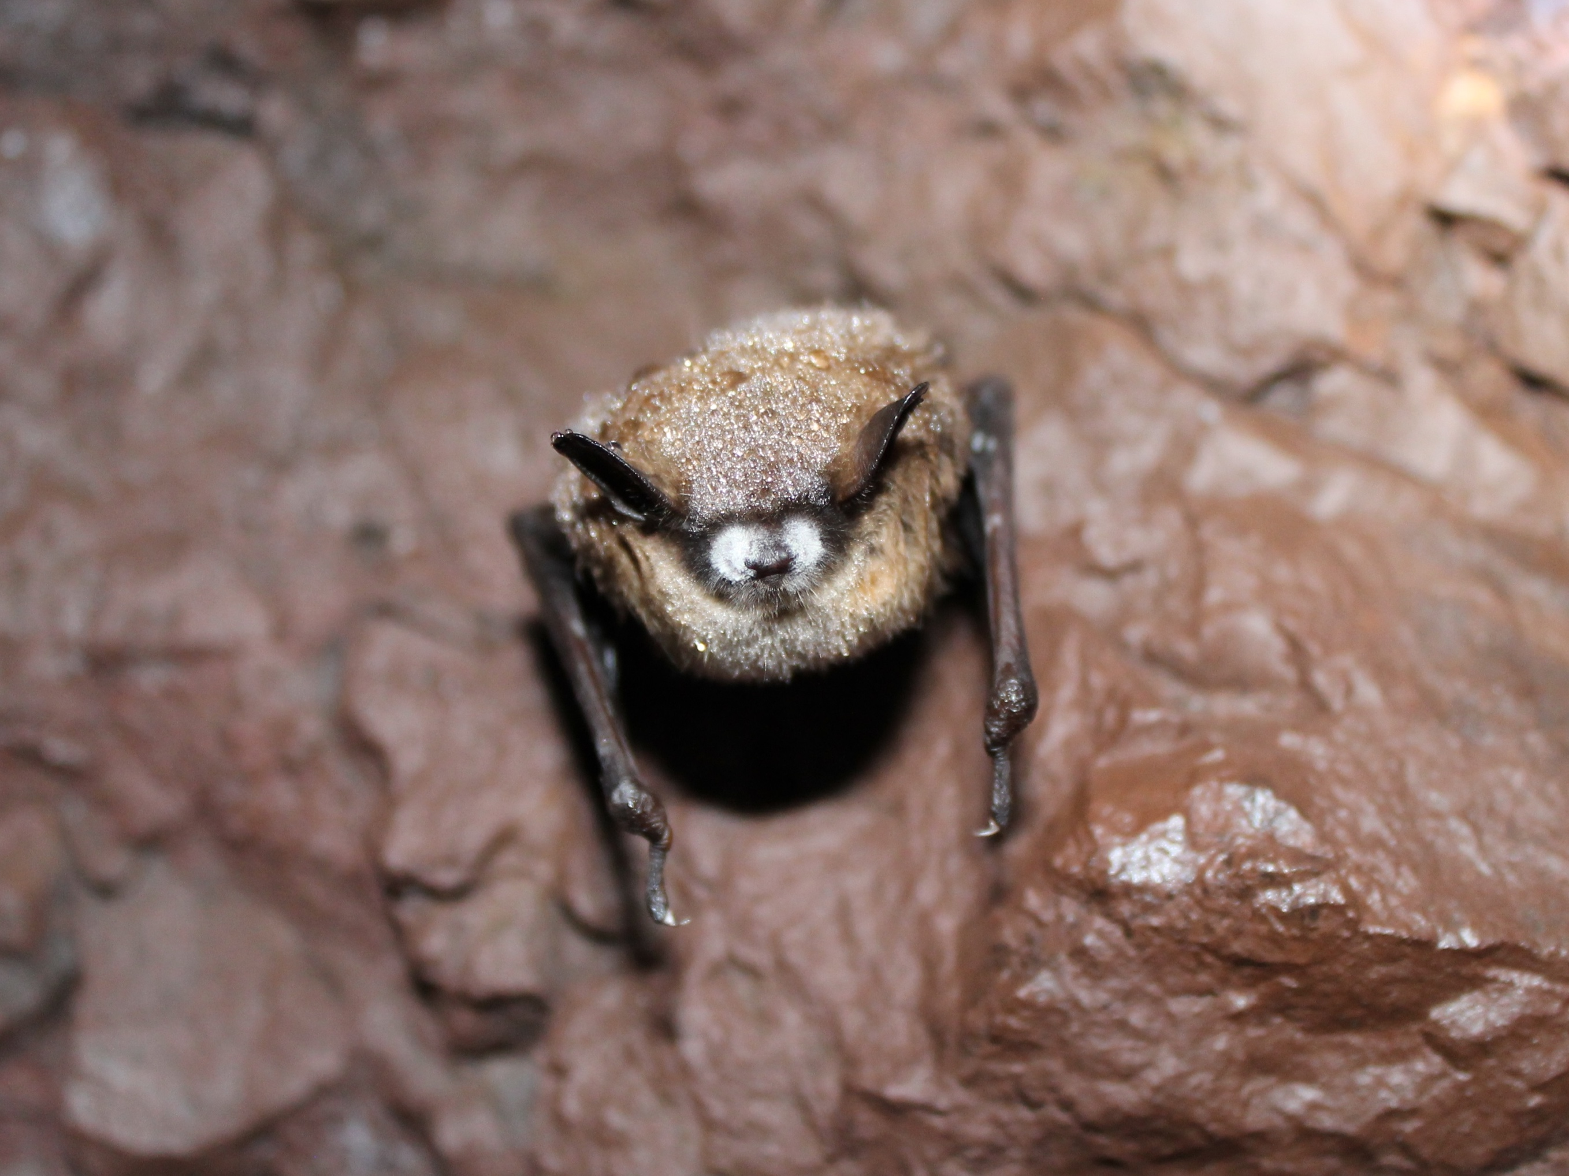
How has temperature dependent survival modified bat thermal niches?

Slide 31
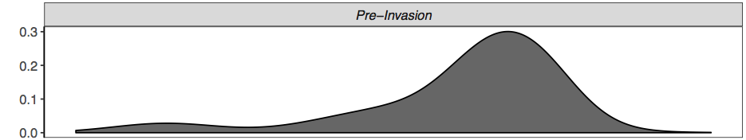
A
Epidemic:
Filtering removes individuals from warmest roosts
N = 6438
Notes:
After WNS invades and causes declines, we see a shift in bat roosting temperatures. Bats on average begin roosting at cooler temperatures

Slide 32
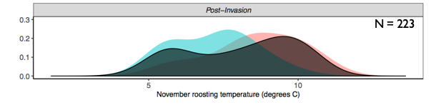
A
Epidemic:
Filtering removes individuals from warmest roosts
N = 6438
Distribution shift
Ecological traps
or sinks
Notes:
After WNS invades and causes declines, we see a shift in bat roosting temperatures. Bats on average begin roosting at cooler temperatures

Slide 33
Why aren’t all bats using cooler roosts?
There is a small physiological advantage toward arousing at warmer temperatures
Absolute humidity and temperature are coupled, and bats need high absolute humidity to prevent dehydration
Colder temperature sites are less stable and bats risk freezing
Temperature →
Cartoon by S. Hopkins
Notes:
THIS raises the question of why there hasn’t been MORE learning or selection for more bats to use cooler roosts. One possibility is that bats are already physiologically constrained by energy demands during hibernation. For instance, bats use slightly less energy during arousal events when they’re in warmer microsites. microsite temperature and absolute humidity are coupled – such that bat homeostatis might be easier to maintain at warmer microclimates and cold microclimates might be less stable – they’re OK sometimes, but bats also might risk freezing by using them if temperatures drop too low. All of these details might cause bats to continue to prefer warmer roosts, despite high disease-induced mortality rates

Slide 34

Ecological solutions: Temperature manipulation of hibernacula
Collaborators & MI DNR discuss their efforts to cool down a mine in the Upper Peninsula
Venting warm air from a PA hibernation site (Turner 2021 Cons Bio)

Slide 35
Your goals
Questions:
What temperatures do different species of bats prefer, globally?
How does outside temperature influence the temperature of hibernation sites?
Do different species choose different temperatures or are they stratifying within the site?
Notes on the data:
The dataset includes individual bats measured with a laser temperature thermometer inside hibernacula during winter
There are two datasets – one of North American bats and one of bats internationally
You will need to link climate data (not provided) using the geographic locations of the sites

Slide 36
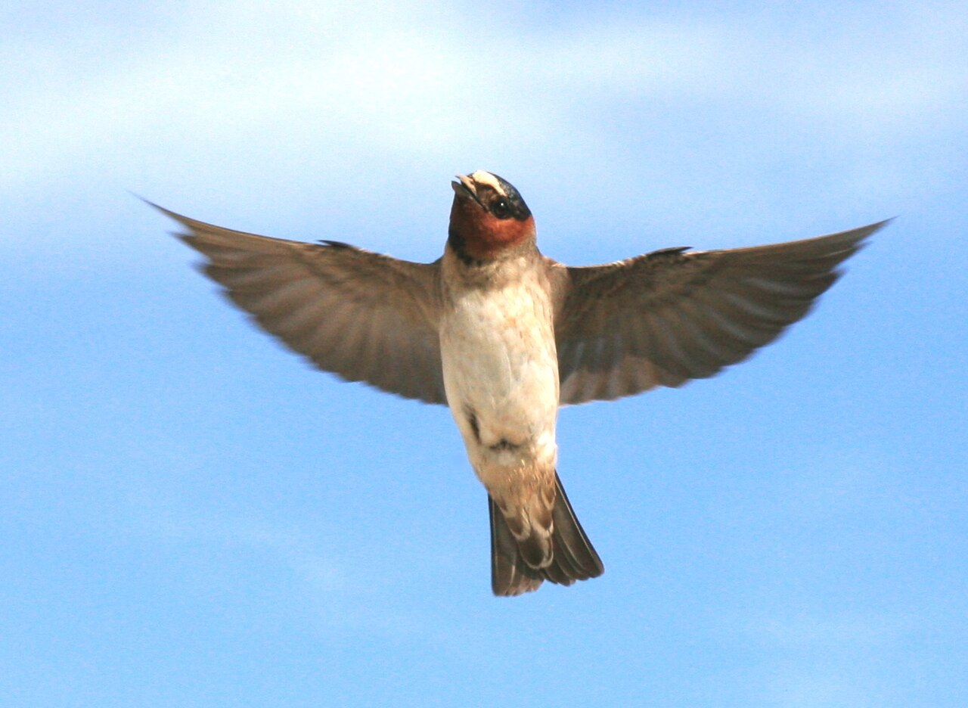
Cliff swallows
Colonial birds (Petrochelidon pyrrho) that nest in groups
Charles Brown (last author on paper Reeb et al. Bio Letters) has been collecting data from Nebraska for 43 years
Encourage you to watch this: https://www.youtube.com/watch?v=VnnPOaf1Dpc
Eat flying insects
Build nests out of mud beneath cliff ledges, bridges, etc.

Slide 37
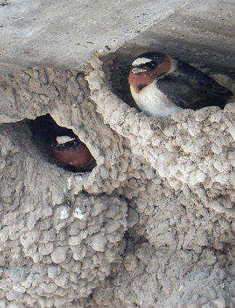
Coloration
They have a white patch on their heads (more on this later)

Slide 38
Climate vulnerability
https://hprcc.unl.edu/
Swallows eat insects and thus changes in climate will affect food availability
Precipitation is known to affect insects, and has resulted in swallow declines

Slide 39
Cliff Swallow Project
https://www.cliffswallow.org/
Began in Western Nebraska (Cedar Point Biological Station) in 1982 and s home to 300 cliff swallow colonies of varying sizes

Slide 40
Reeb at al. Bio Letters
Q: Does the white forehead patch on swallows indicate nest occupancy?
H: more prominent patches (brighter, larger) should enhance signal functions and be associated with birds that nest
(i) in larger colonies that have greaters numbers of intruding neighbors
OR
(ii) spend more time in the nest

Slide 41
Methods
Studied preserved skins of cliff swallows (e.g. dead birds) from SW Nebraska
Colony size was determined as the max number of active nests in a given breeding seasons
Measured white forehead patches of the birds (a bunch of the data is verifying techniques for measuring these)
Also did an experiment where they colored in bird forehead patches with black markers

Slide 42
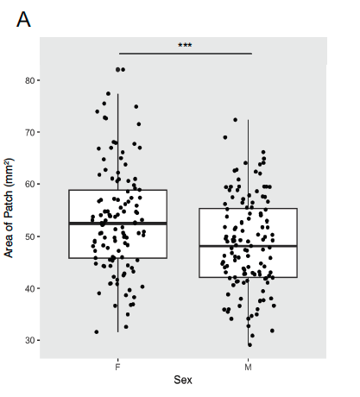
Sex-based differences in size of white patch

Slide 43
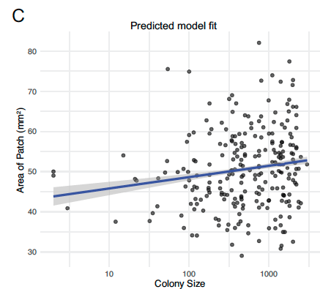
Increases in colony size are correlated with area of the patch

Slide 44
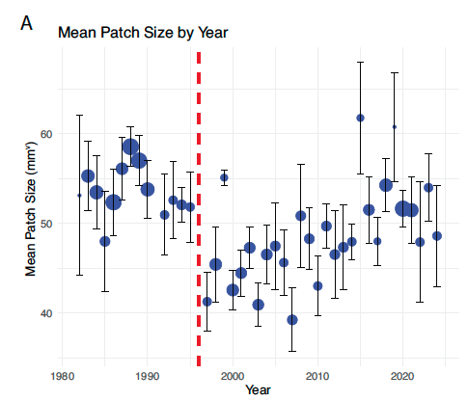
Patch size and brightness vary a lot by year

Slide 45
Your goals
Potential questions:
What is the relationship between patch size and climate?
How has climate influenced the size of cliff swallow colonies?
Other questions of interest!
Notes on the data:
The dataset includes individual swallows and their patch measurements along with colony sizes in different years
There are a number of other datasets associated with the paper – you can examine the README to figure out what you need, but the primary dataset is 5NovPatchData.csv
Feel free to explore other data from the project
You will need to add in climate data from Western Nebraska

Slide 46
Cliff Swallow Project Resources
Watch this video from the principal investigator:
https://www.youtube.com/watch?v=VnnPOaf1Dpc
Take a look at the project website:
https://www.cliffswallow.org/
Explore the webpage from Cedar Point Bio station:
https://cedarpoint.unl.edu/research-and-teaching/natural-history-and-science/

Slide 47
Annotated bibliography instructions and short research proposal
An annotated bibliography is a bibliography that gives a summary of each of the papers provided
The goal of the assignment is to include a document that has:
(1) A short overview (1-2 paragraphs of text) that outlines:
1. some background, synthesized from the papers
2. states your questions
3. makes hypotheses or predictions
4. Explains steps you are going to take to explore these questions (including obtaining more data)
(2) An annotated bibliography of 5 annotated citations per group member (total 15-20).
Remember to download these into your citation manager!
Important: Not all papers will be about your system!!!

Slide 48
How to find papers
Search in web of science or google scholar
Look at citations (references) from the papers where the datasets came from!
Necessary background will not just be from the system!
For example, both datasets include climate data – a seminal paper on climate change is this one:
Parmesan 2003 Nature - https://www.nature.com/articles/nature01286
This could be a good ‘background’ paper for exploring your questions
Delhey 2020 Current Biology - https://www.sciencedirect.com/science/article/pii/S0960982220316134
This paper discussed how coloration might change with climate
Consider the quality of the journal when accessing a paper
Journals have impact factors (higher=better) which can provide context to the importance and quality of a study
Beware of articles from predatory journals and articles from publisher MDPI

Slide 49
How to describe papers in your bibliography
Expect to include 2-4 sentences of description per paper
Your summary should include:
The question the paper is trying to answer
The main take home result
Any additional relevance on why you included the citation (e.g. could have useful data); this isn’t necessary but is helpful

